Slide 1






SNAKE GAME
START!

Slide 2
Introduction
Overview:
Evolution of an AI-driven Snake game through FOUR versions.
Focused on improving adaptability, learning efficiency, and performance.
Motivation:
Demonstrate reinforcement learning applications in dynamic environments.
Solve challenges in AI behavior optimization.

Slide 3
Objectives
Develop an AI agent capable of adapting to static and dynamic environments.
Improve reward structures and obstacle challenges.
Optimize training time and efficiency.
Achieve higher scores with advanced learning techniques.

Slide 4
VERSION 1 - BASELINE
ENVIRONMENT: STANDARD SNAKE GAME ENVIRONMENT.
Key Features:
No obstacles.
Simple reward function: +10 for food, -10 for collisions.
Limitations:
No model saving.
Inefficient training process.
Low highest score (~40).

Slide 5
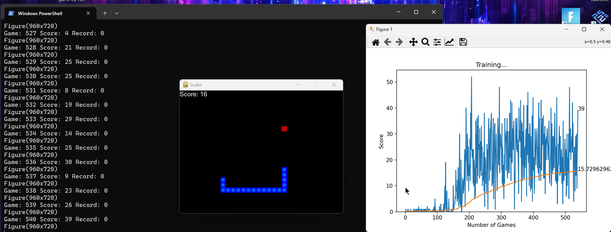
SNAPSHOTS FROM THE GAME AND TRAINING GRAPH.

Slide 6
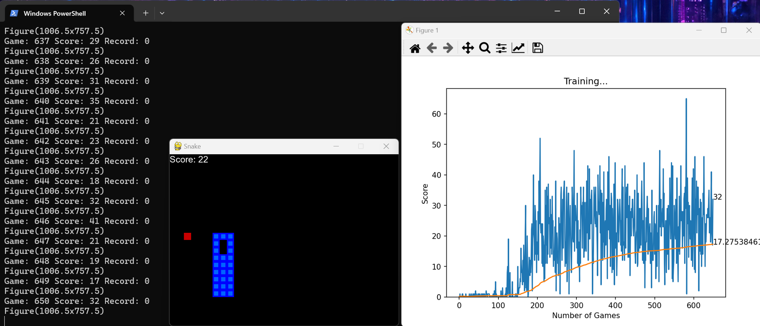
SNAPSHOTS FROM THE GAME AND TRAINING GRAPH.

Slide 7
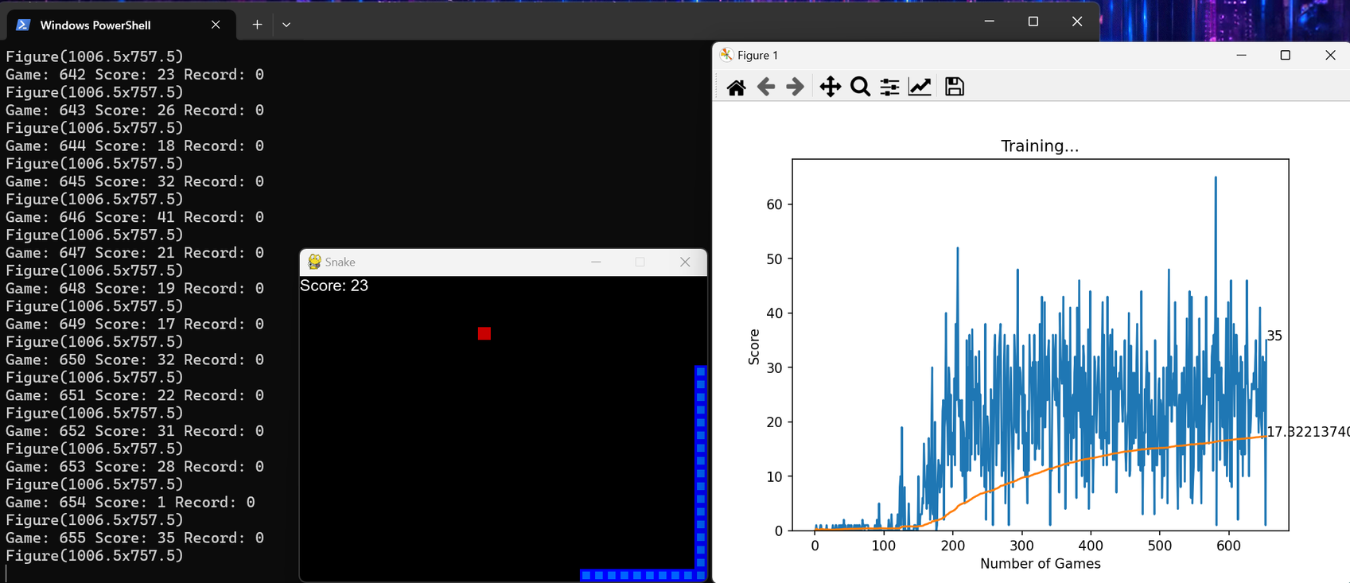
SNAPSHOTS FROM THE GAME AND TRAINING GRAPH.

Slide 8
VERSION 2 - INITIAL IMPROVEMENTS
ENVIRONMENT:
Added rEFINEMENTS to the CODE AND OPTIMIZED IT.
Enhancements:
Introduced SAVING a model and score-saving mechanism.
Optimized training structures to reduce time.
Impact:
Improved performance and highest score.

Slide 9
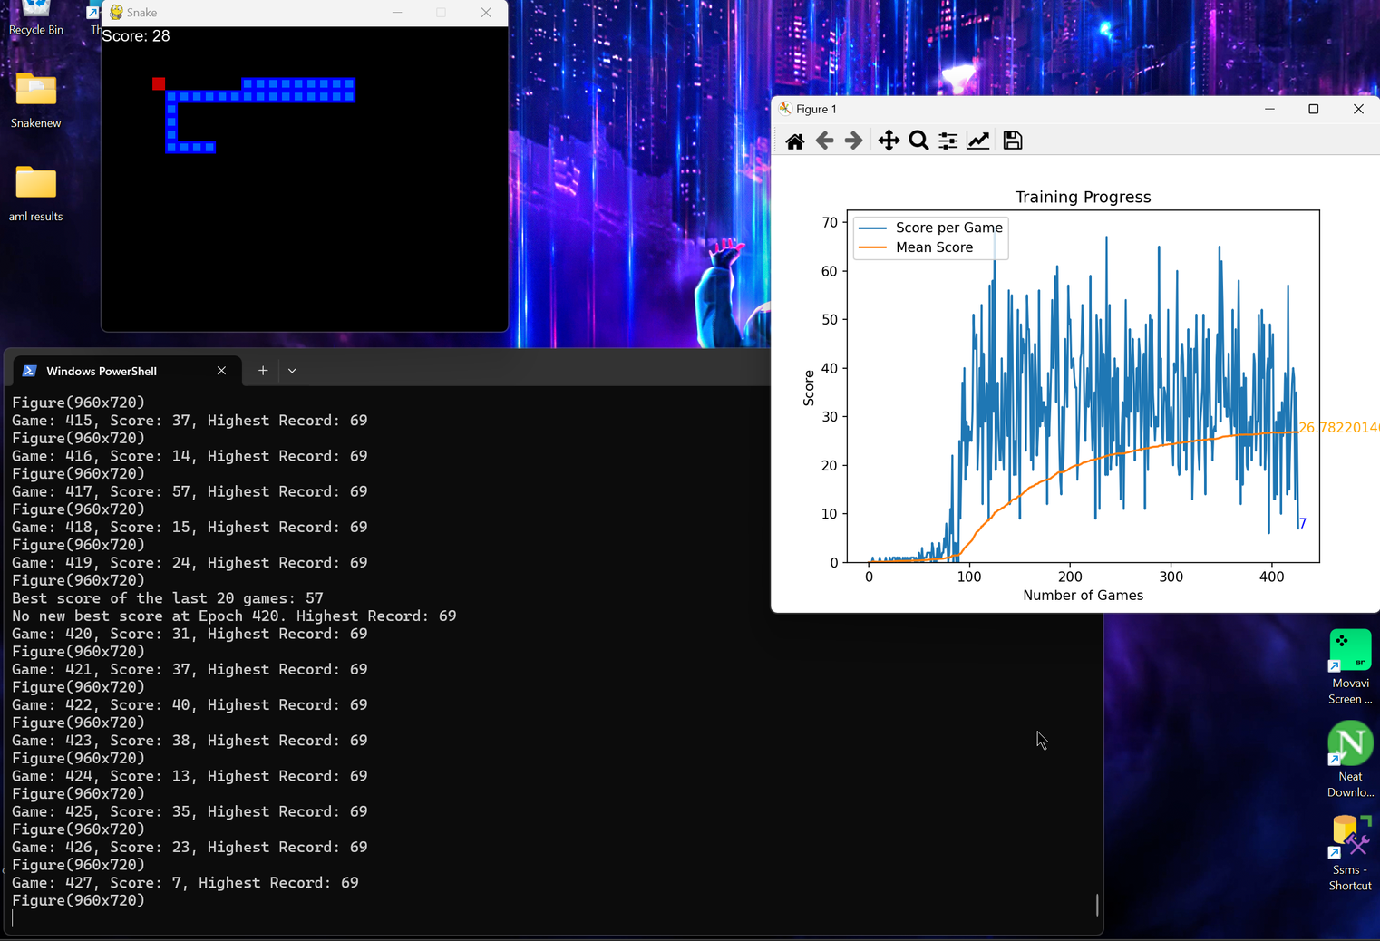
SNAPSHOTS FROM IMPROVED THE GAME AND TRAINING GRAPH.

Slide 10
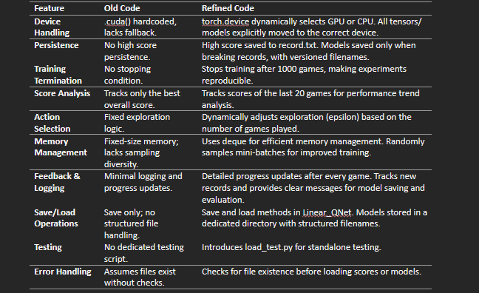
COMPARISON BETWEEN TWO VERSIONS

Slide 11
VERSION 3 - FIXED OBSTACLES
ENVIRONMENT:
Static obstacles with fixed positions.
REWard System:
STAndard rewards with penalties for collisions.
Optimization:
Basic optimizations for better movement strategies.
CHallenges:
LImited adaptability to dynamic challenges.

Slide 12
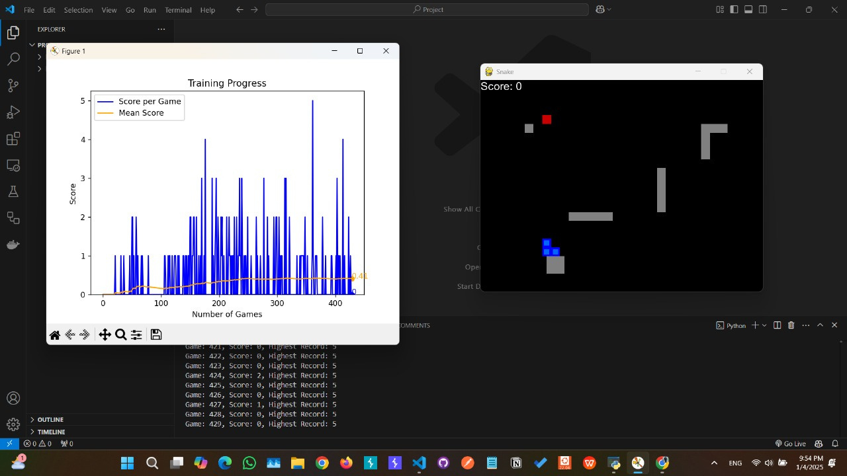
SNAPSHOTS FROM FIXED OBSTACLES
VERSION- V1

Slide 13
VERSION 4 - OPTIMIZATION
REWARD SYSTEM ENHANCEMENTS:
+1 for moving closer to food.
-1 for moving away from food.
STATE REPresentation:
EXPAnded to include normalized distances and obstacle proximity.
ADVanced Techniques:
Implemented Double DQN for stability.
Neural Network Architecture:
ADDED MORE layers and switched to LeakyReLU activation.
Impact:
Improved learning and stability.

Slide 14
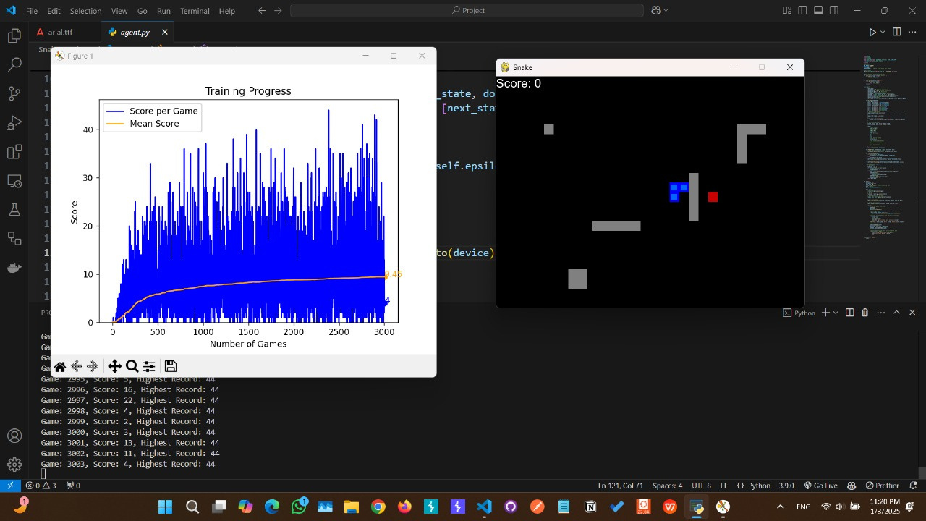
SNAPSHOTS FROM FIXED OBSTACLES
VERSION- V2

Slide 15
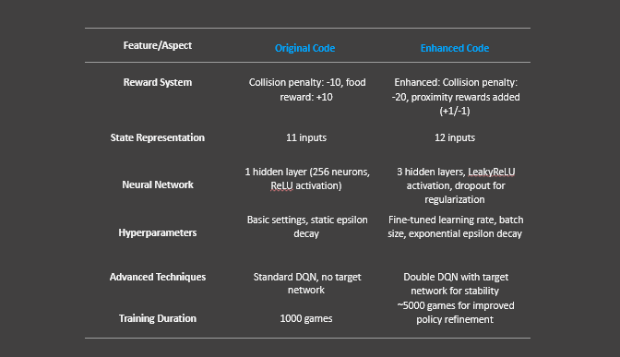
COMPARISON BETWEEN TWO VERSIONS

Slide 16
VERSION 5 - DYNAMIC ENVIRONMENT (POST GAME OVER)
ENVIRONMENT:
Dynamic obstacles spawn after game over.
Adaptability:
AI learns to handle changing obstacle positions.
Training Efficiency:
Extended training time for better learning.
Challenges:
Maintaining performance with increasing difficulty

Slide 17
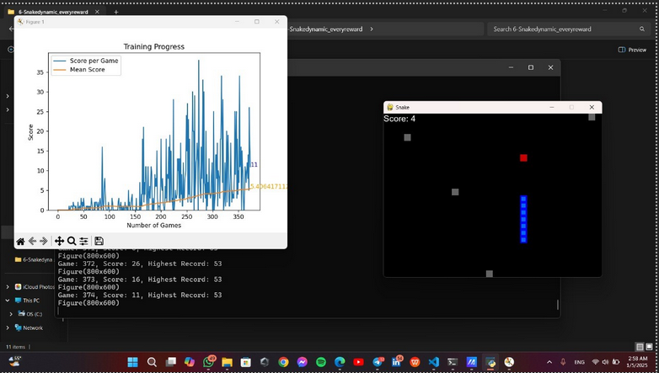
SNAPSHOTS FROM DYNAMIC OBSTACLES (POST GAME OVER)

Slide 18
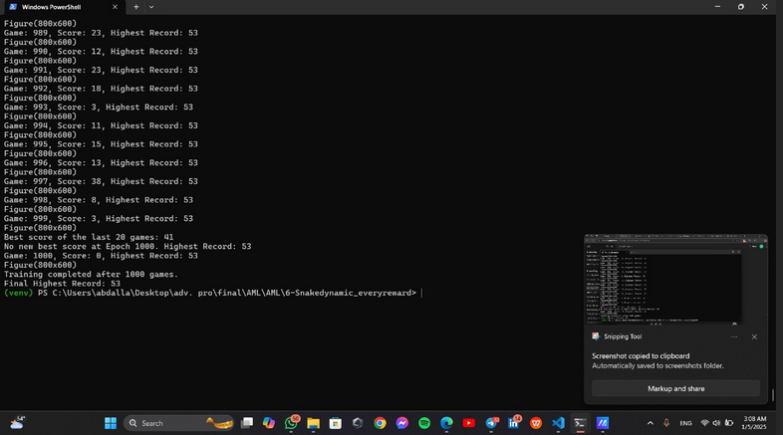
SNAPSHOTS FROM DYNAMIC OBSTACLES (POST GAME OVER)

Slide 19

SNAPSHOTS FROM DYNAMIC OBSTACLES (POST GAME OVER)

Slide 20
VERSION 6 - REWARD-TRIGGERED DYNAMICS
ENVIRONMENT:
MOVIng obstacles after every reward.
REWard System:
ENHANCED reward structure balances food collection and obstacle avoidance.
SCOring Potential:
HIGHESt scoring potential among all versions.
Learning Efficiency
Fully optimized with smooth exploration-to-exploitation transitions.

Slide 21
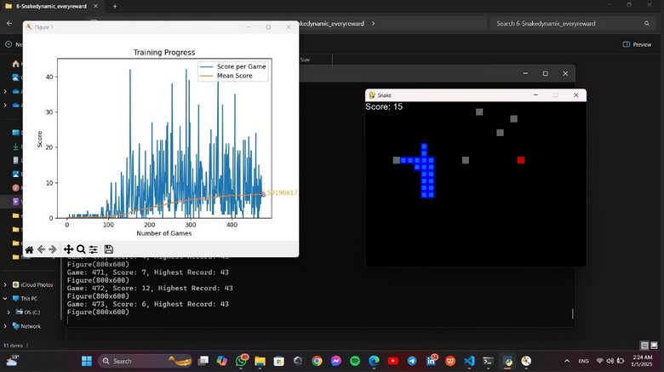
SNAPSHOTS FROM DYNAMIC REWARD-TRIGGERED OBSTACLES

Slide 22
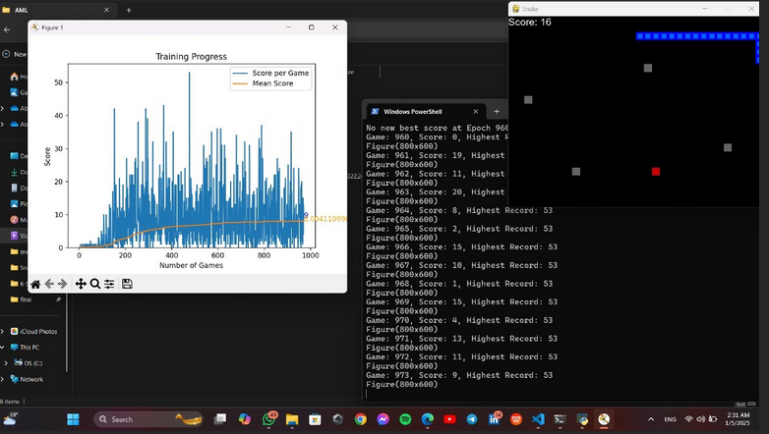
SNAPSHOTS FROM DYNAMIC REWARD-TRIGGERED OBSTACLES

Slide 23
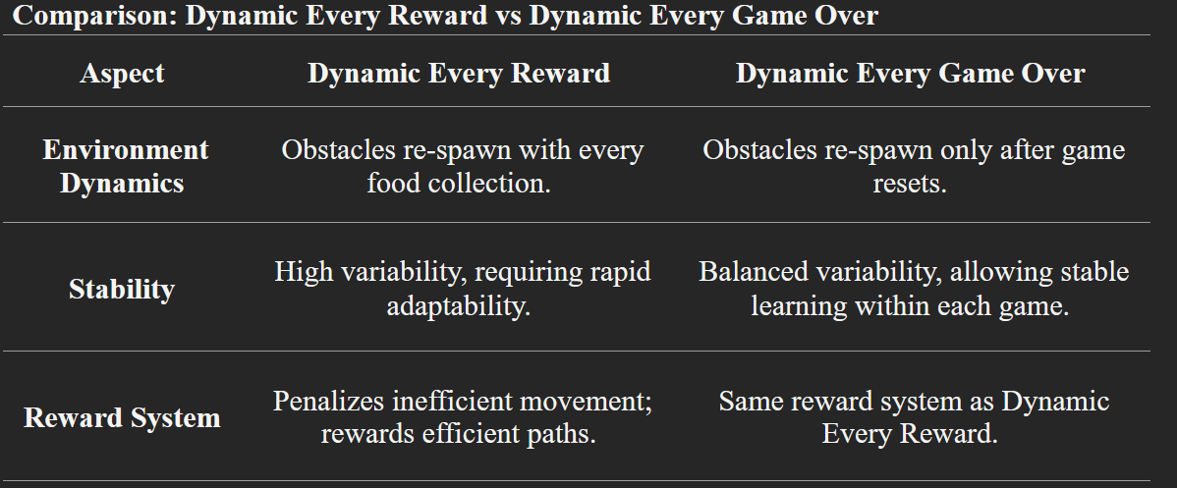
COMPARISON BETWEEN TWO VERSIONS

Slide 24
CONCLUSION
Summary:
Significant improvements achieved through six iterative versions.
Transition from static to dynamic environments increased AI complexity and performance.
Future Improvements:
Incorporate multi-agent systems for collaborative learning.
Test in more complex, real-world-inspired environments.

Slide 25
TEAM
AHMED HASSANY 221100128
YASEEN WALEED 221100979
NOUR MAHER 221101140
YOUSSEF GAMAL 221101013
ABDULLAH HOSSAM 221100049

Slide 26
THANK YOU
END

